Slide 1
Procedimientos Almacenados
https://www.postgresql.org/docs/9.6/plpgsql.html

Slide 2
CREATE FUNCTION borrar_actas_curso(_id_curso integer,
_id_semestre integer)
RETURNS integer LANGUAGE plpgsql
AS $function$
DECLARE
_res integer;
BEGIN
_res := 0;
return _res;
END;
$function$;

Slide 3
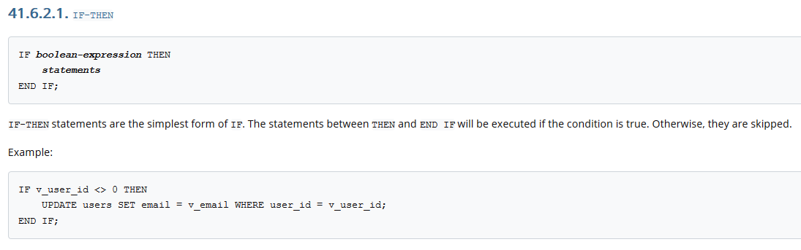

Slide 4
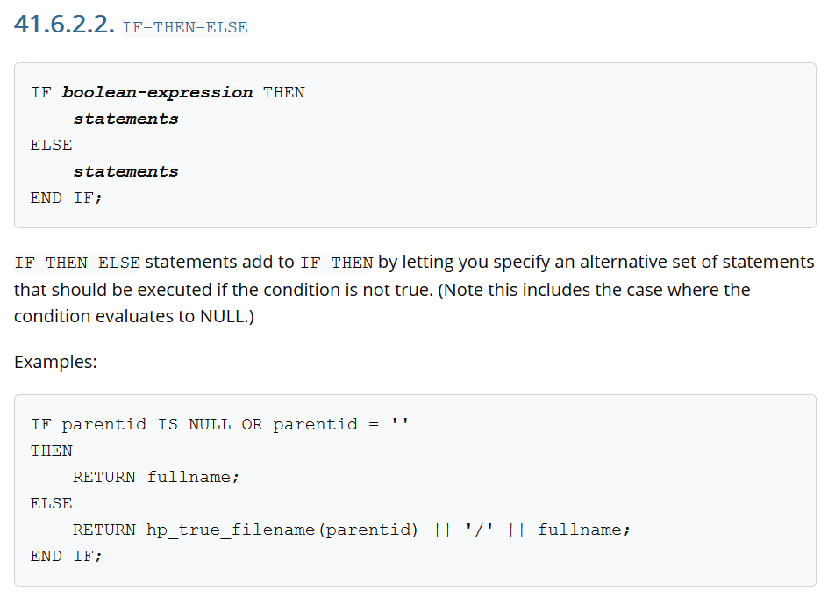

Slide 5
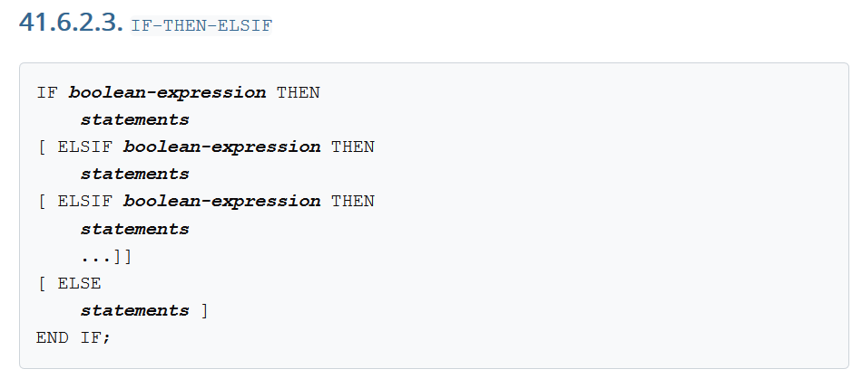
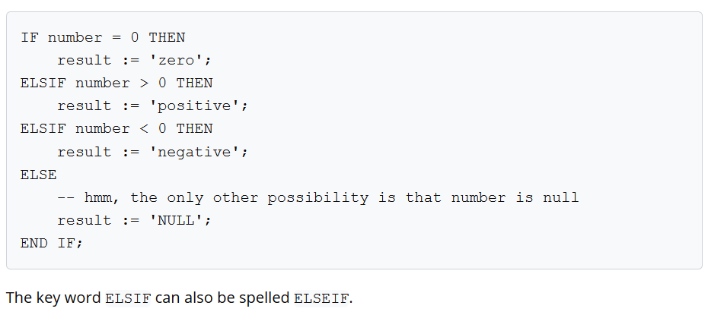

Slide 6
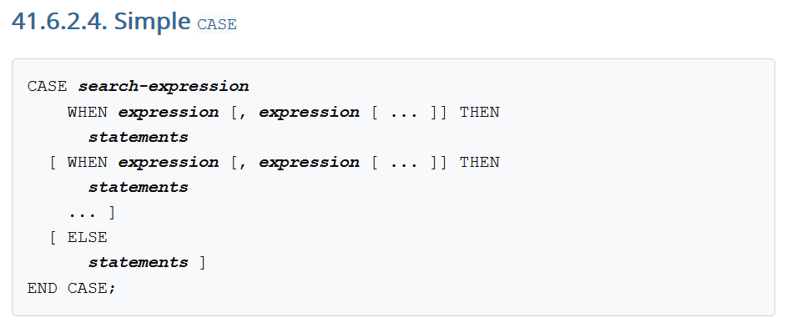
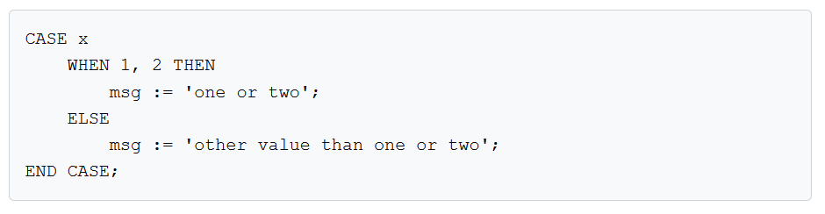

Slide 7
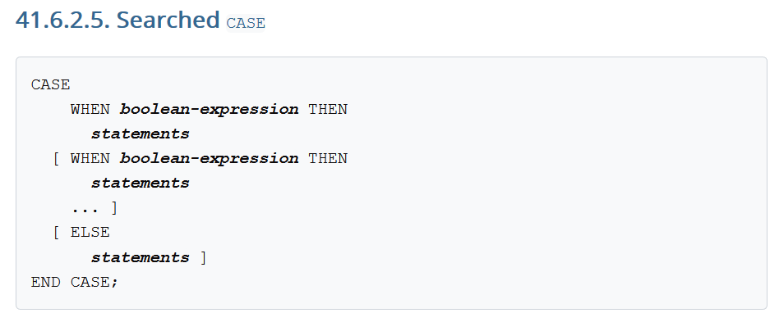
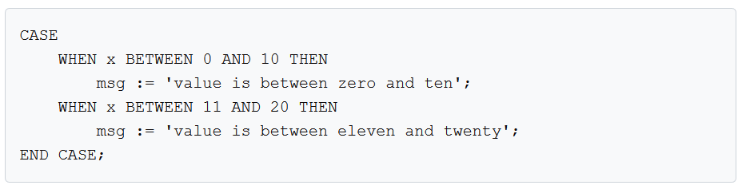

Slide 8
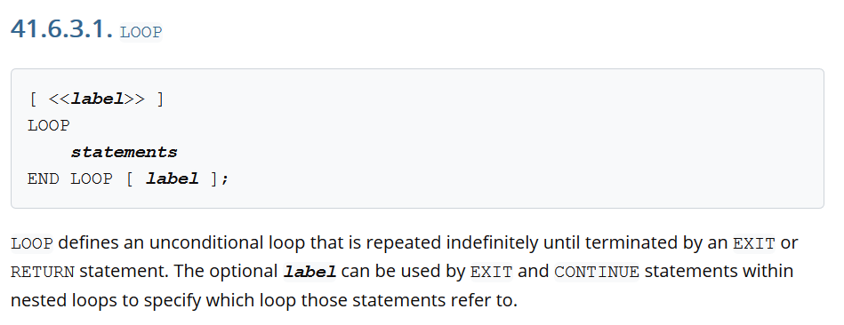
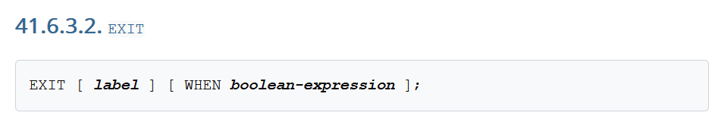

Slide 9
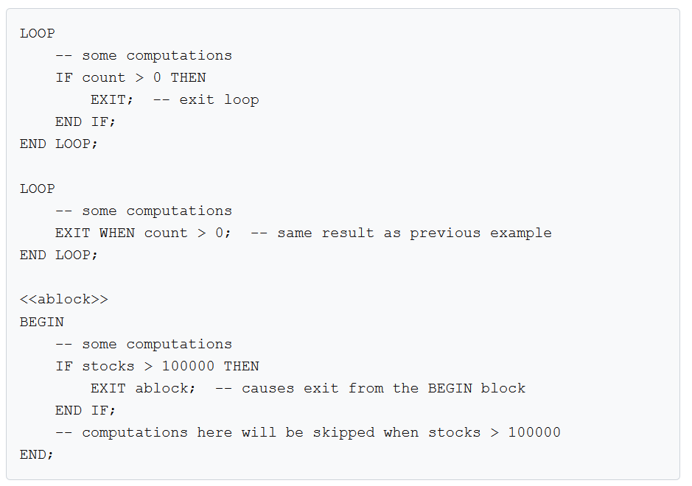

Slide 10
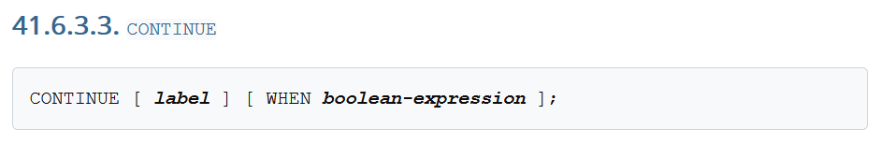
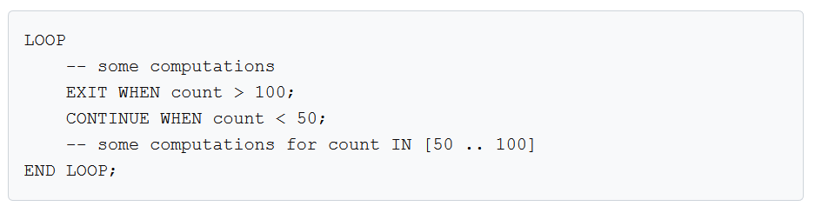

Slide 11
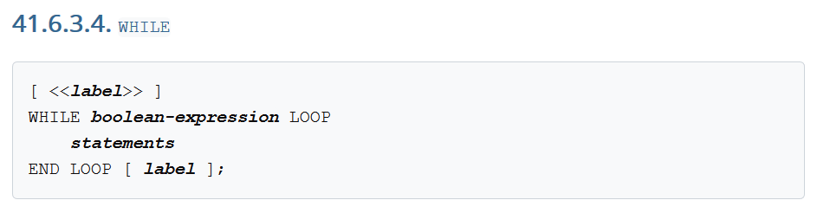
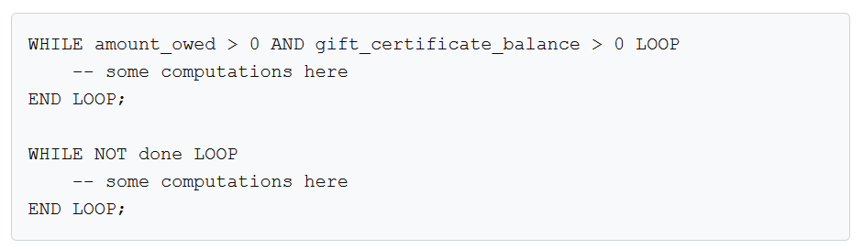

Slide 12
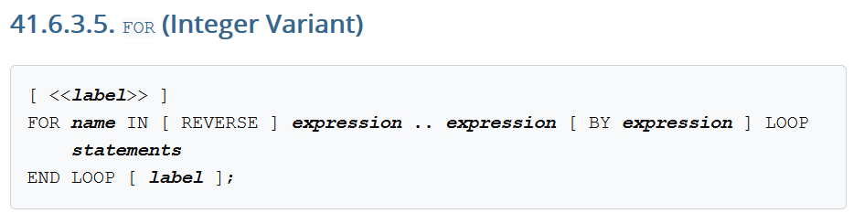
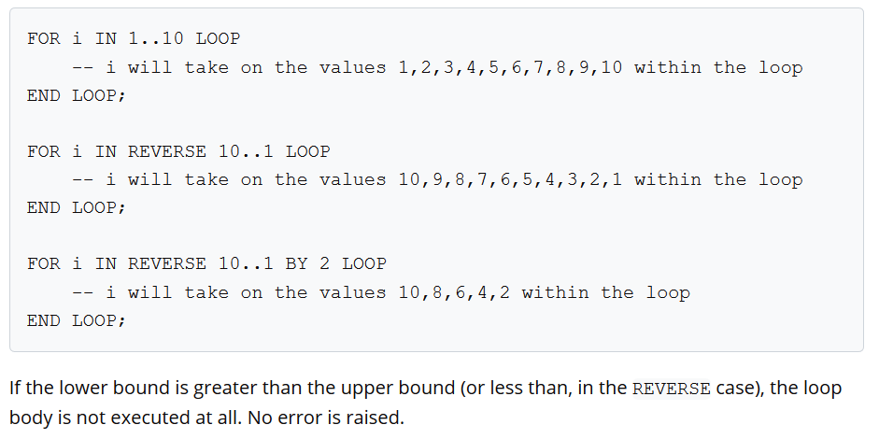

Slide 13
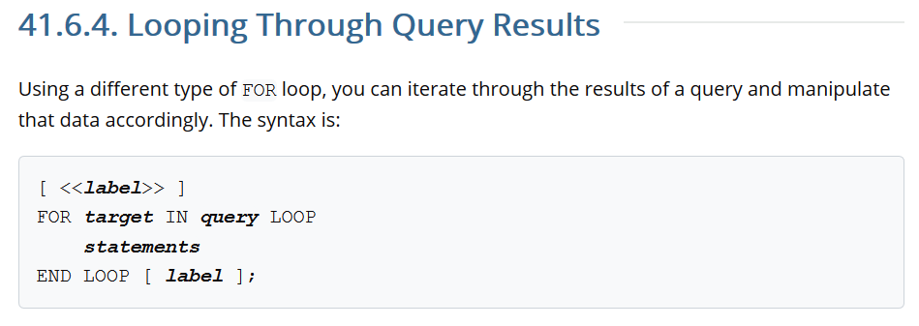

Slide 14
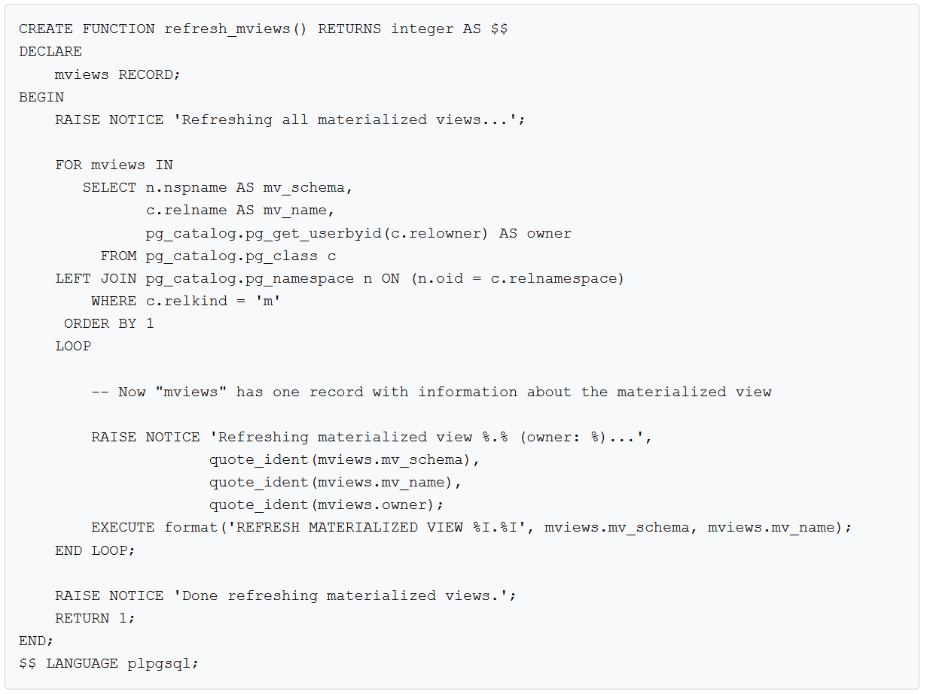

Slide 15
Usos

Slide 16
select nombre,
codigo,
seccion as paralelo,
get_profesores_curso(curso.id,
(select id
from semestre
where semestre_banner = '202020’)
) as profesor
from curso
where codigo like 'ECIN-00200'

Slide 17
Triggers

Slide 18
Overview of Trigger Behavior
A trigger is a specification that the database should automatically execute a particular function whenever a certain type of operation is performed.
On tables and foreign tables, triggers can be defined to execute either before or after any INSERT, UPDATE, or DELETE operation, either once per modified row, or once per SQL statement.

Slide 19
Overview of Trigger Behavior
The trigger function must be defined before the trigger itself can be created. The trigger function must be declared as a function taking no arguments and returning type trigger.
Once a suitable trigger function has been created, the trigger is established with CREATE TRIGGER. The same trigger function can be used for multiple triggers.

Slide 20
Overview of Trigger Behavior
PostgreSQL offers both per-row triggers and per-statement triggers.
With a per-row trigger, the trigger function is invoked once for each row that is affected by the statement that fired the trigger.
In contrast, a per-statement trigger is invoked only once when an appropriate statement is executed, regardless of the number of rows affected by that statement.

Slide 21
Overview of Trigger Behavior
Triggers are also classified according to whether they fire before, after, or instead of the operation.
These are referred to as BEFORE triggers, AFTER triggers, and INSTEAD OF triggers respectively.
Statement-level BEFORE triggers naturally fire before the statement starts to do anything, while statement-level AFTER triggers fire at the very end of the statement.

Slide 22
Overview of Trigger Behavior
A row-level trigger fired before an operation has the following choices:
It can return NULL to skip the operation for the current row. This instructs the executor to not perform the row-level operation that invoked the trigger (the insertion, modification, or deletion of a particular table row).
For row-level INSERT and UPDATE triggers only, the returned row becomes the row that will be inserted or will replace the row being updated. This allows the trigger function to modify the row being inserted or updated.

Slide 23
Overview of Trigger Behavior
The return value is ignored for row-level triggers fired after an operation, and so they can return NULL.

Slide 24
Uses
Typically, row-level BEFORE triggers are used for checking or modifying the data that will be inserted or updated.
For example, a BEFORE trigger might be used to insert the current time into a timestamp column, or to check that two elements of the row are consistent.
Row-level AFTER triggers are most sensibly used to propagate the updates to other tables, or make consistency checks against other tables.
The reason for this division of labor is that an AFTER trigger can be certain it is seeing the final value of the row, while a BEFORE trigger cannot.

Slide 25
Cascading
If a trigger function executes SQL commands then these commands might fire triggers again.
This is known as cascading triggers.
There is no direct limitation on the number of cascade levels. It is possible for cascades to cause a recursive invocation of the same trigger.

Slide 27
CREATE OR REPLACE FUNCTION log_last_name_changes()
RETURNS TRIGGER
LANGUAGE PLPGSQL
AS
$$
BEGIN
IF NEW.last_name <> OLD.last_name THEN
INSERT INTO employee_audits(employee_id,last_name,changed_on)
VALUES(OLD.id,OLD.last_name,now());
END IF;
RETURN NEW;
END;
$$
CREATE TRIGGER last_name_changes
BEFORE UPDATE
ON employees
FOR EACH ROW
EXECUTE PROCEDURE log_last_name_changes();

Slide 28
Variables especiales
OLD
NEW
Dependen del contexto
 | OLD | NEW
Insert | NULL | 👍
Delete | 👍 | NULL
Update | 👍 | 👍
https://www.postgresql.org/docs/9.1/plpgsql-trigger.html

